Slide 1
Intro to Hackathons
hackathon tips & tricks
Notes:
As students begin to enter, have a Poll Everywhere question up: https://beta.polleverywhere.com/
- For a video, the interactive part won’t make sense
It asks them why they are here – why they want to be at the Hackathon. There is a slide asking the question, where students should have a chance to discuss their answers.

Slide 2
hylandtechoutreach.github.io/hackathon
Notes:
Show the students this site – it has a lot of helpful resources, including this presentation and links.

Slide 3
Why are you here?
Notes:
Ask the students why they signed up for the hackathon. This can help guide the introductory discussion. Some of them may want to build something, some of them may want to learn about software development, some of them might want to meet new people, some of them may have been forced into it by parents or teachers… whatever their reasons, they all ended up here. Hopefully they answered in the poll, but ask the question to the students. Also ask them why they might be at the workshop specifically.

Slide 4
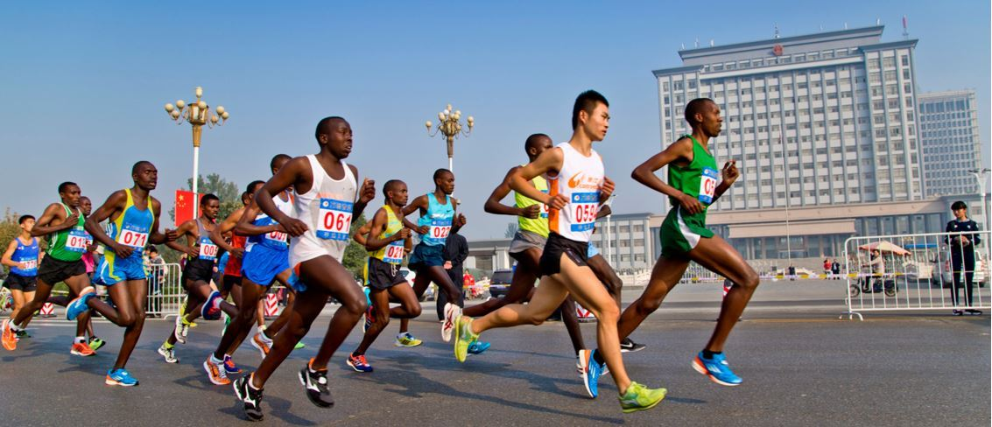
What is a hackathon?
A Hacking Marathon
The goal is to build a complete software project
Teams and ideas can be established ahead of time, or during the event
All code for the project must be written during the event
Notes:
Explain WHAT a hackathon is: you “hack” something together in a short amount of time. Note that “Hacking” in this instance does not mean breaking into anything – it’s all about building

Slide 5

Fresh Code rule
At most hackathons (including ours), no part of your project may have been created before the start of the hackathon. Code must be “fresh”
Fresh code ≠ looking up code
Feel free to reference previous projects
You’re more than welcome to look up examples
Google is a great resource, used by professional developers every day! Feel free to look up things you may not know
Notes:
Mention the fresh code rule.

Slide 6
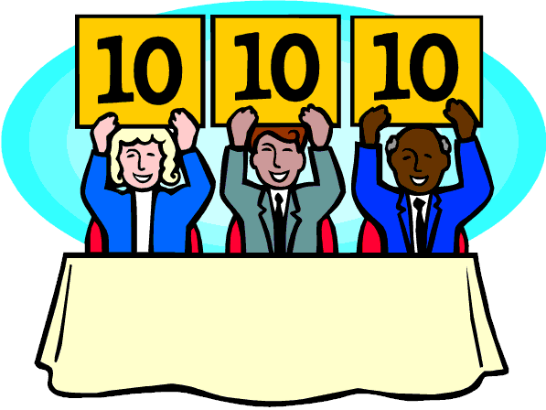
The judgment process
The judges are aware you built your project in only two days. They know you may not have a fully working product
Sometimes, pitch is just as important as product
Create good presentation materials
Make it fun, show your enthusiasm!
Record yourself practicing and watch it back to improve
Hint: Mentors and other teams make great practice dummies
Notes:
Sometimes, the pitch can be just as important as the product, if not more important. It’s worth taking some time to practice it. Talk about the important aspects of the judging process.

Slide 7
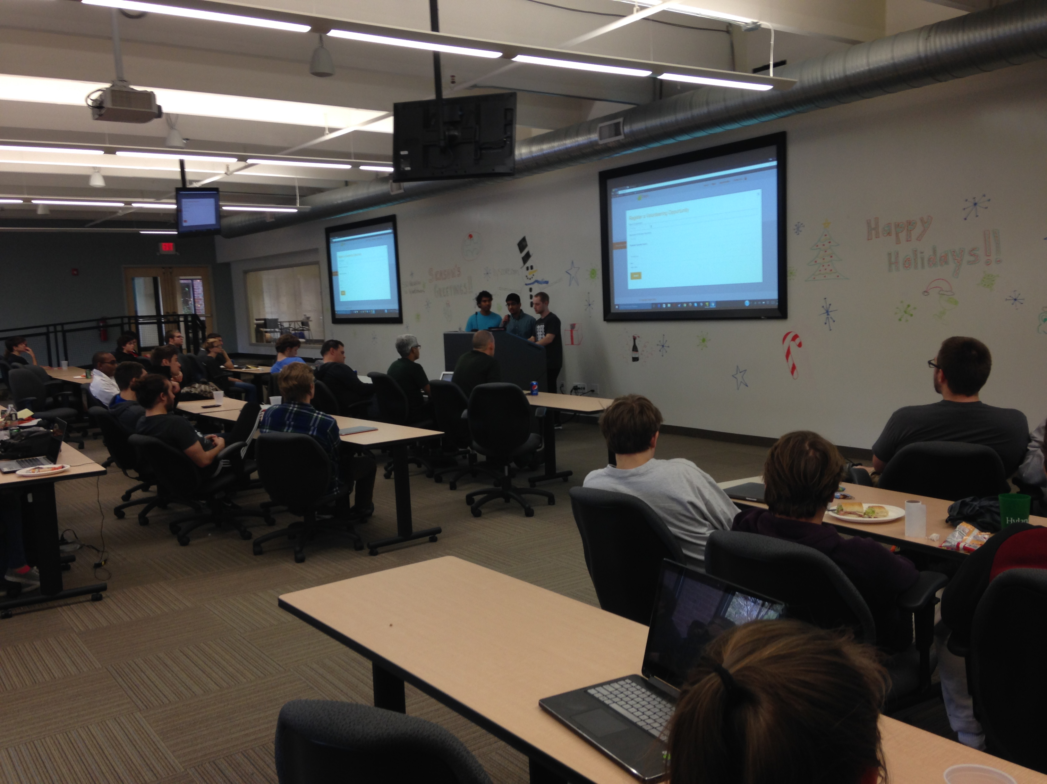
Notes:
Picture of what the final round presentations will look like

Slide 8
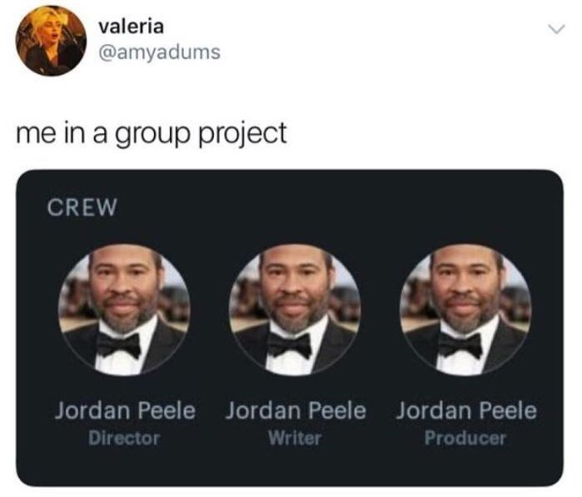
Project time
Notes:
Contrary to what this picture may indicate, teamwork is important!

Slide 9
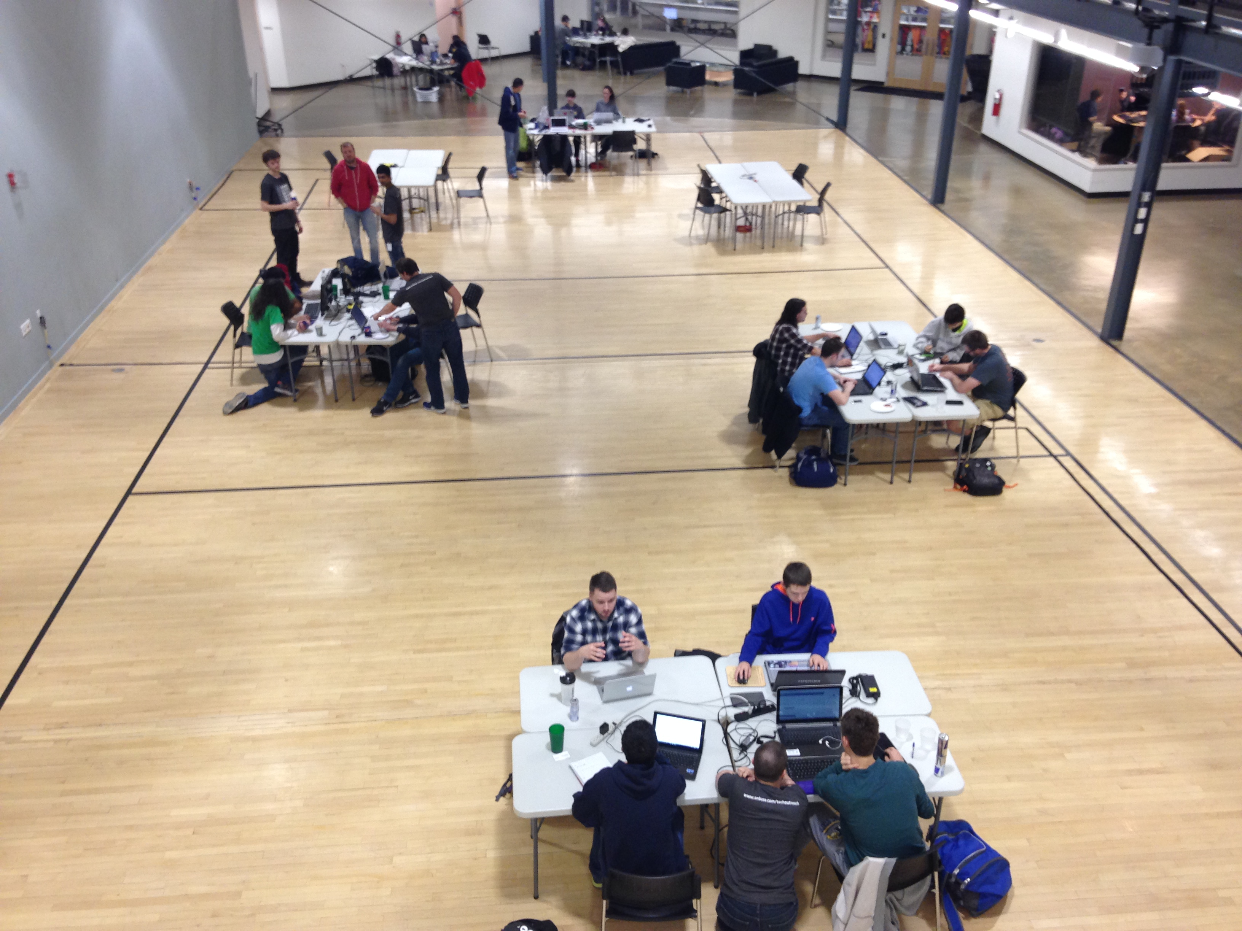

Slide 10
How to decide on a project
Try to think of a problem that exists, and find a software solution
Explore a new technology by building something with it
Think of something that you want to exist, and bring it to life!
Ideas
Website/Web App
Blockchain
VR / AR
A.I.
Social Media App
Game

Slide 11
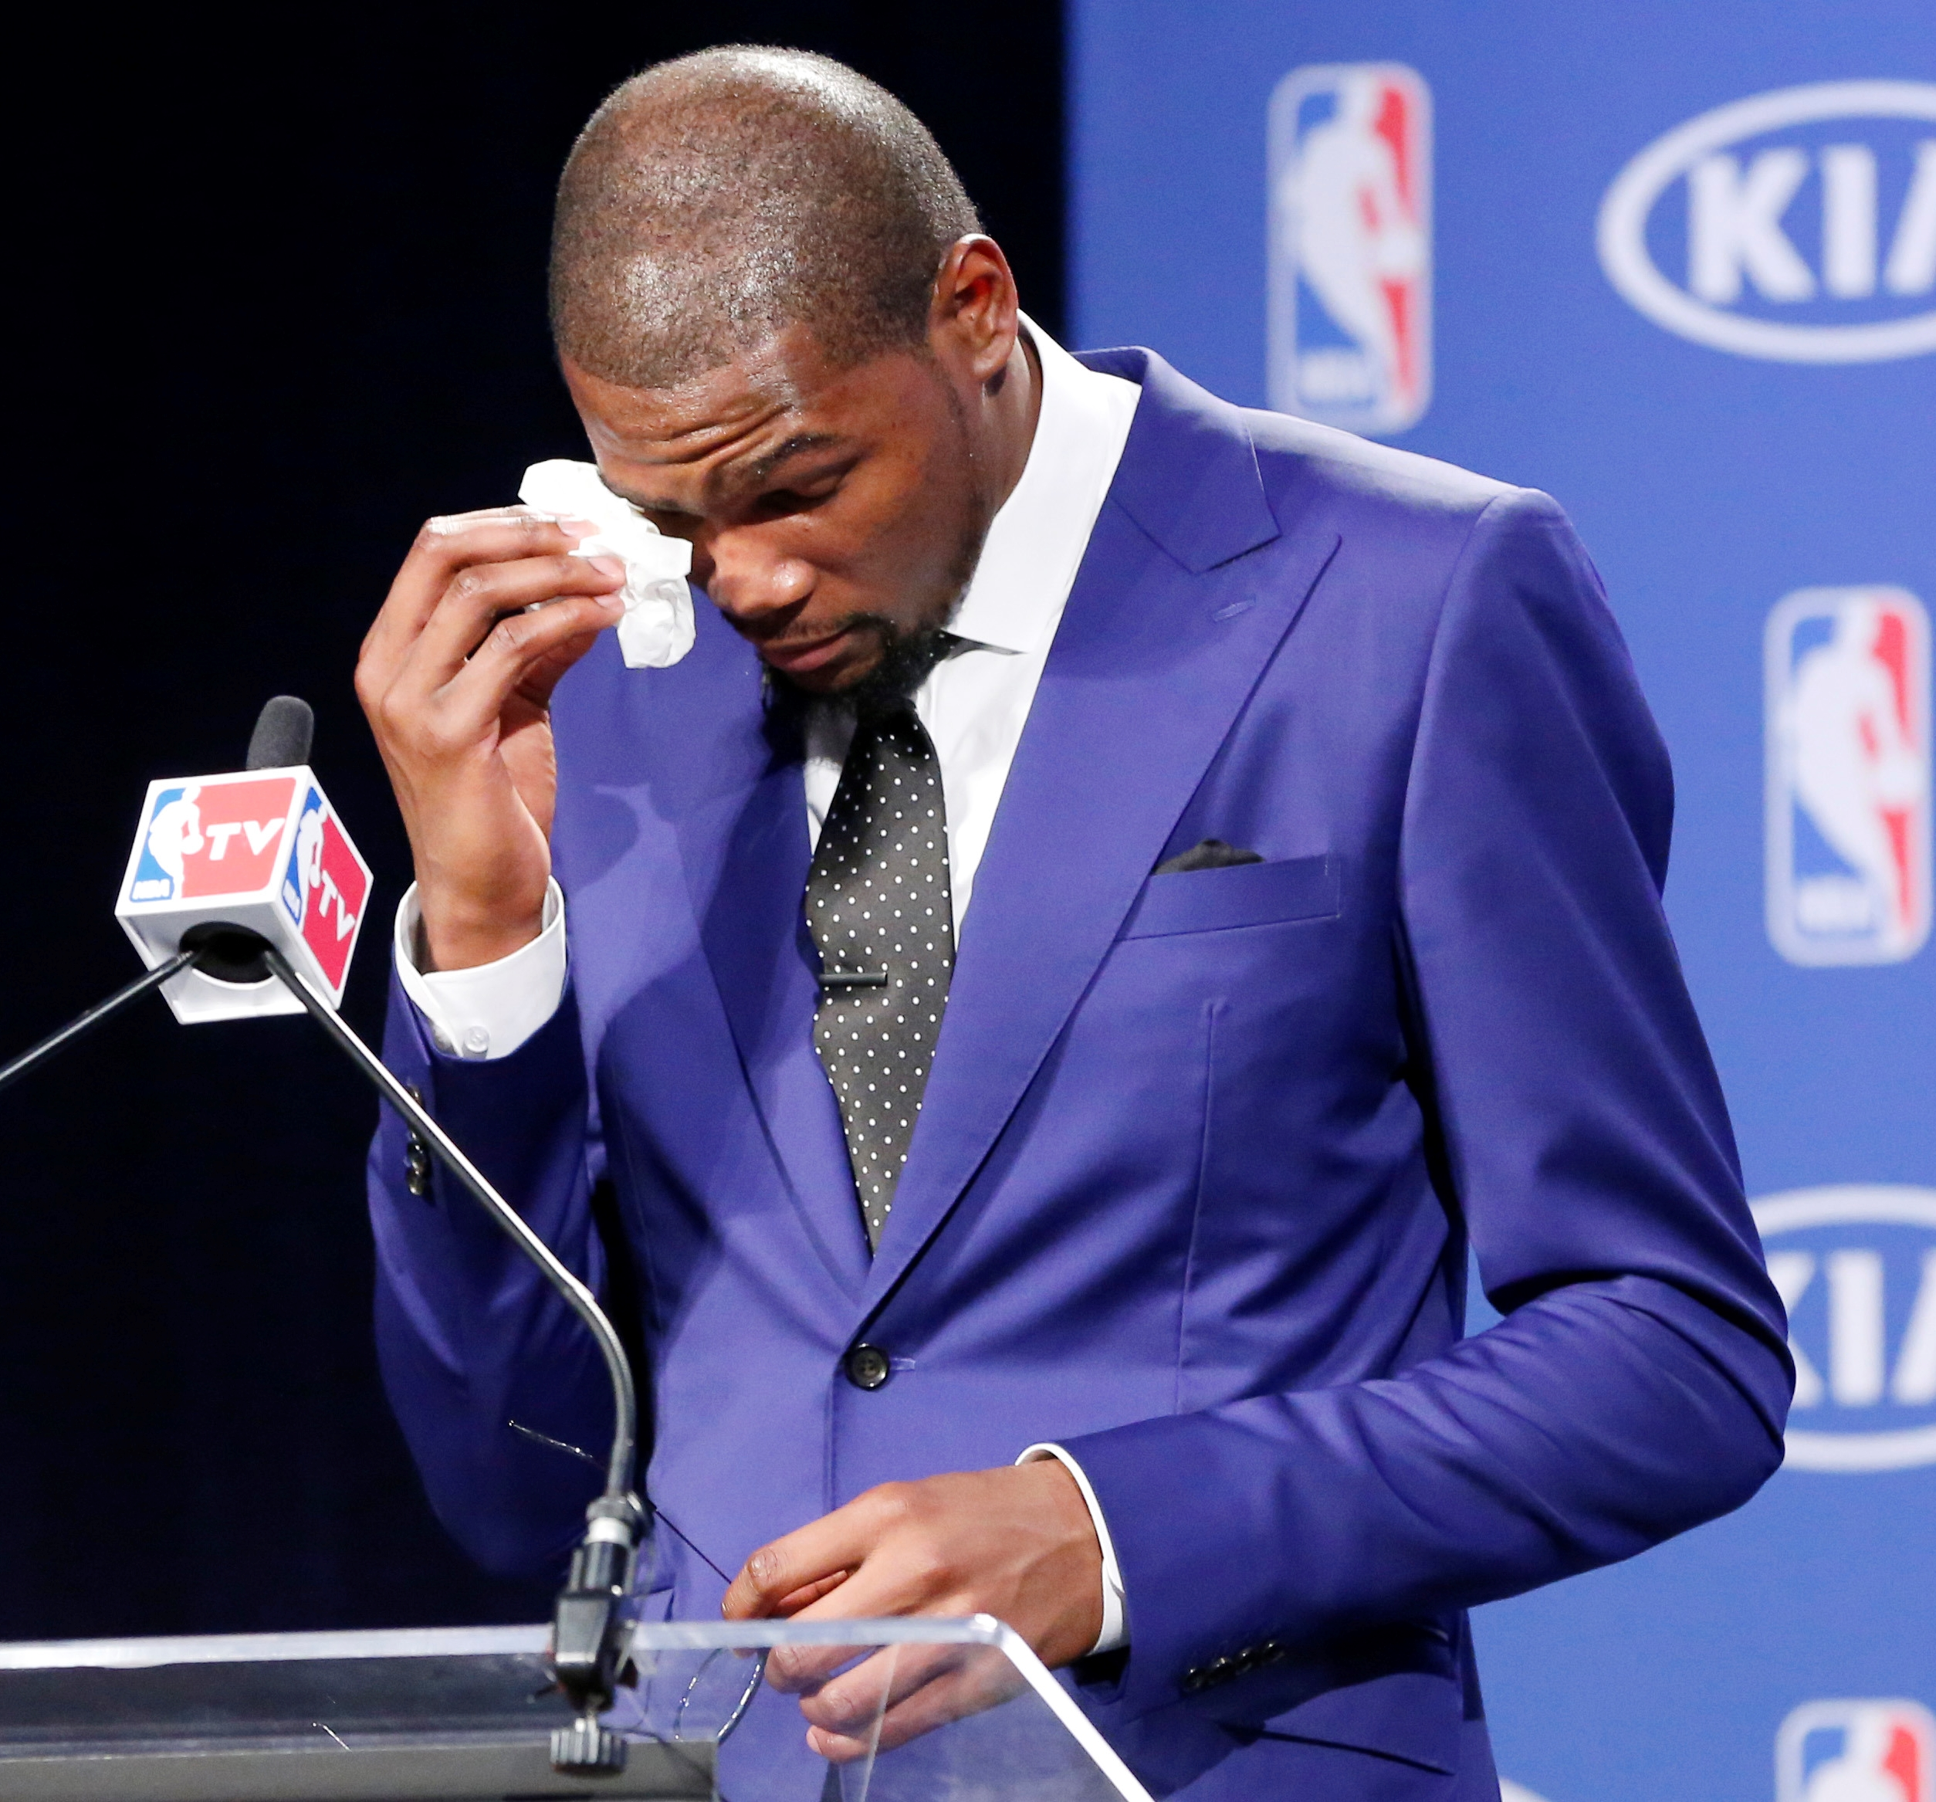
Focusing on an M.V.P.
Minimum Viable Product
A version of a product with just enough features to be usable
Figure out the highest priority features, and work on those
Create something demo-able, even if it’s not releasable
Focus on what’s interesting
Notes:
It’s important that students scope their projects appropriately, and don’t get too caught up in little details. For example, they shouldn’t spend hours working on a login page or aligning some text – they should move on to bigger things.

Slide 12
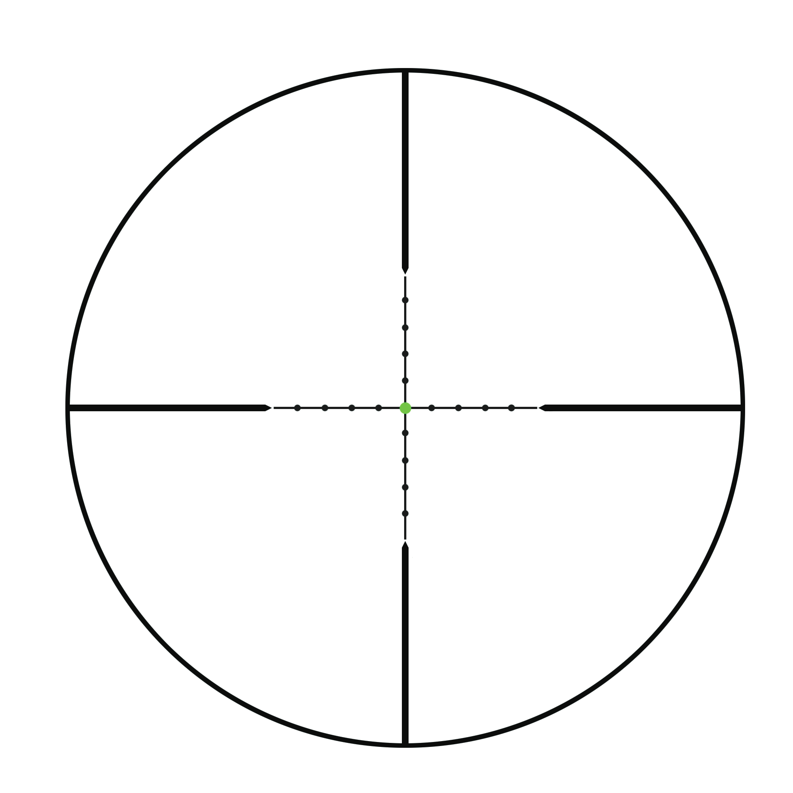









Project Scope
What can you finish before the deadline?
Scope – the amount of work needed to complete a project
Make sure your aspirations are not too ambitious – decide which features are doable
Speed things up by using existing libraries when possible
Notes:
Projects should be possible to “complete” within the time frame – but try not to let it limit you. Ask the students if they know what scope is.

Slide 13

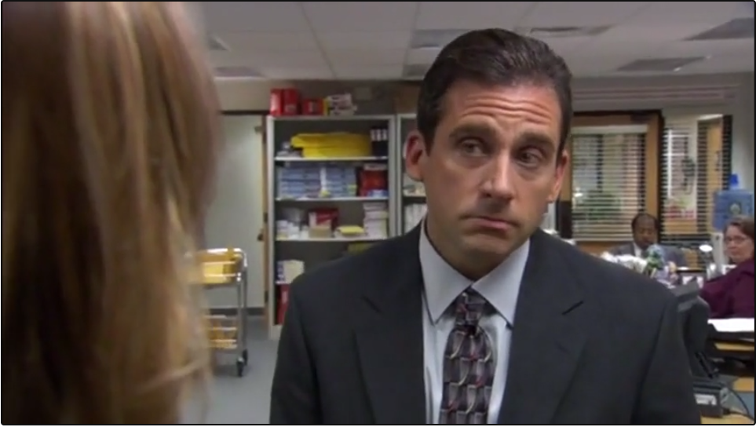

Time to work – How to collaborate
Keep Talking
Delegate Tasks
Figure out who can do what
Switch Roles Frequently
Be supportive of each other!
Driver & Observer
Notes:
The number one rule of collaboration, especially in a virtual environment, is to KEEP TALKING. This can be on Discord, or any other communication channel.
One of the first things to do is figure out who can do what. Every team member will have certain skills – figure out who can do what!
When it’s time to start writing code, one way to collaborate is to write code with a partner – using pair programming. In this method, there are two people coding at one computer. One should be writing code, and the other should be watching. The driver is responsible for writing the code, while the observer watches for errors and provides guidance. It is important to switch roles frequently with this method.
Ultimately, remember that you are a team. Support each other as much as you can.

Slide 14
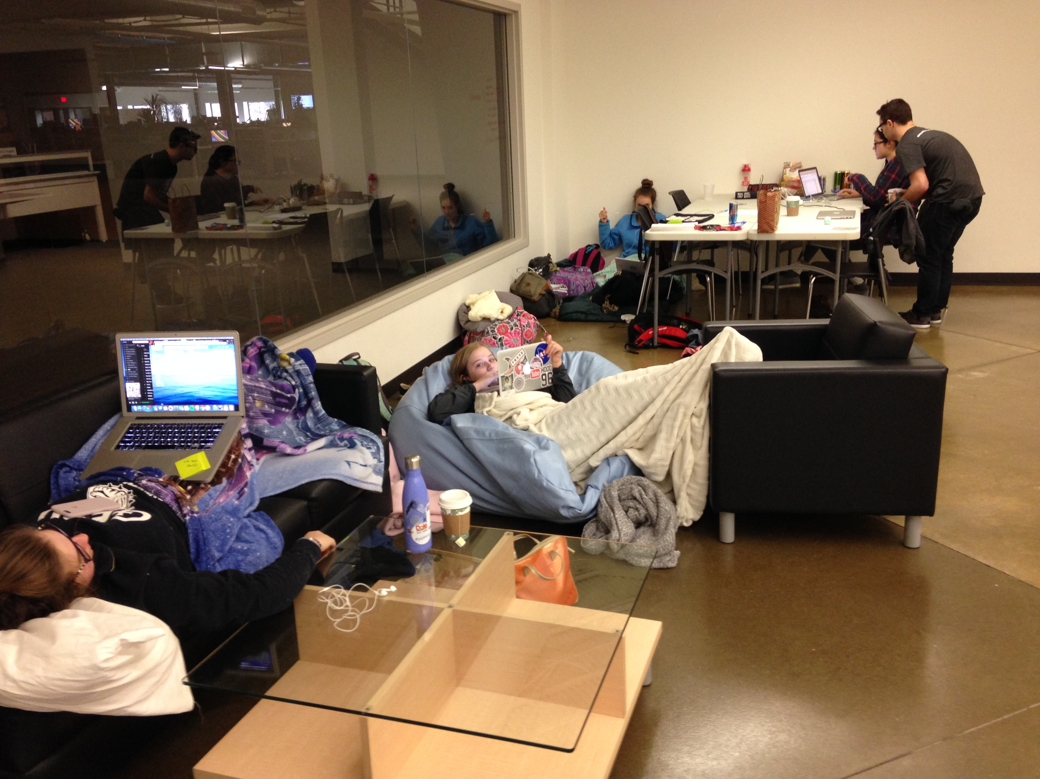

Slide 15
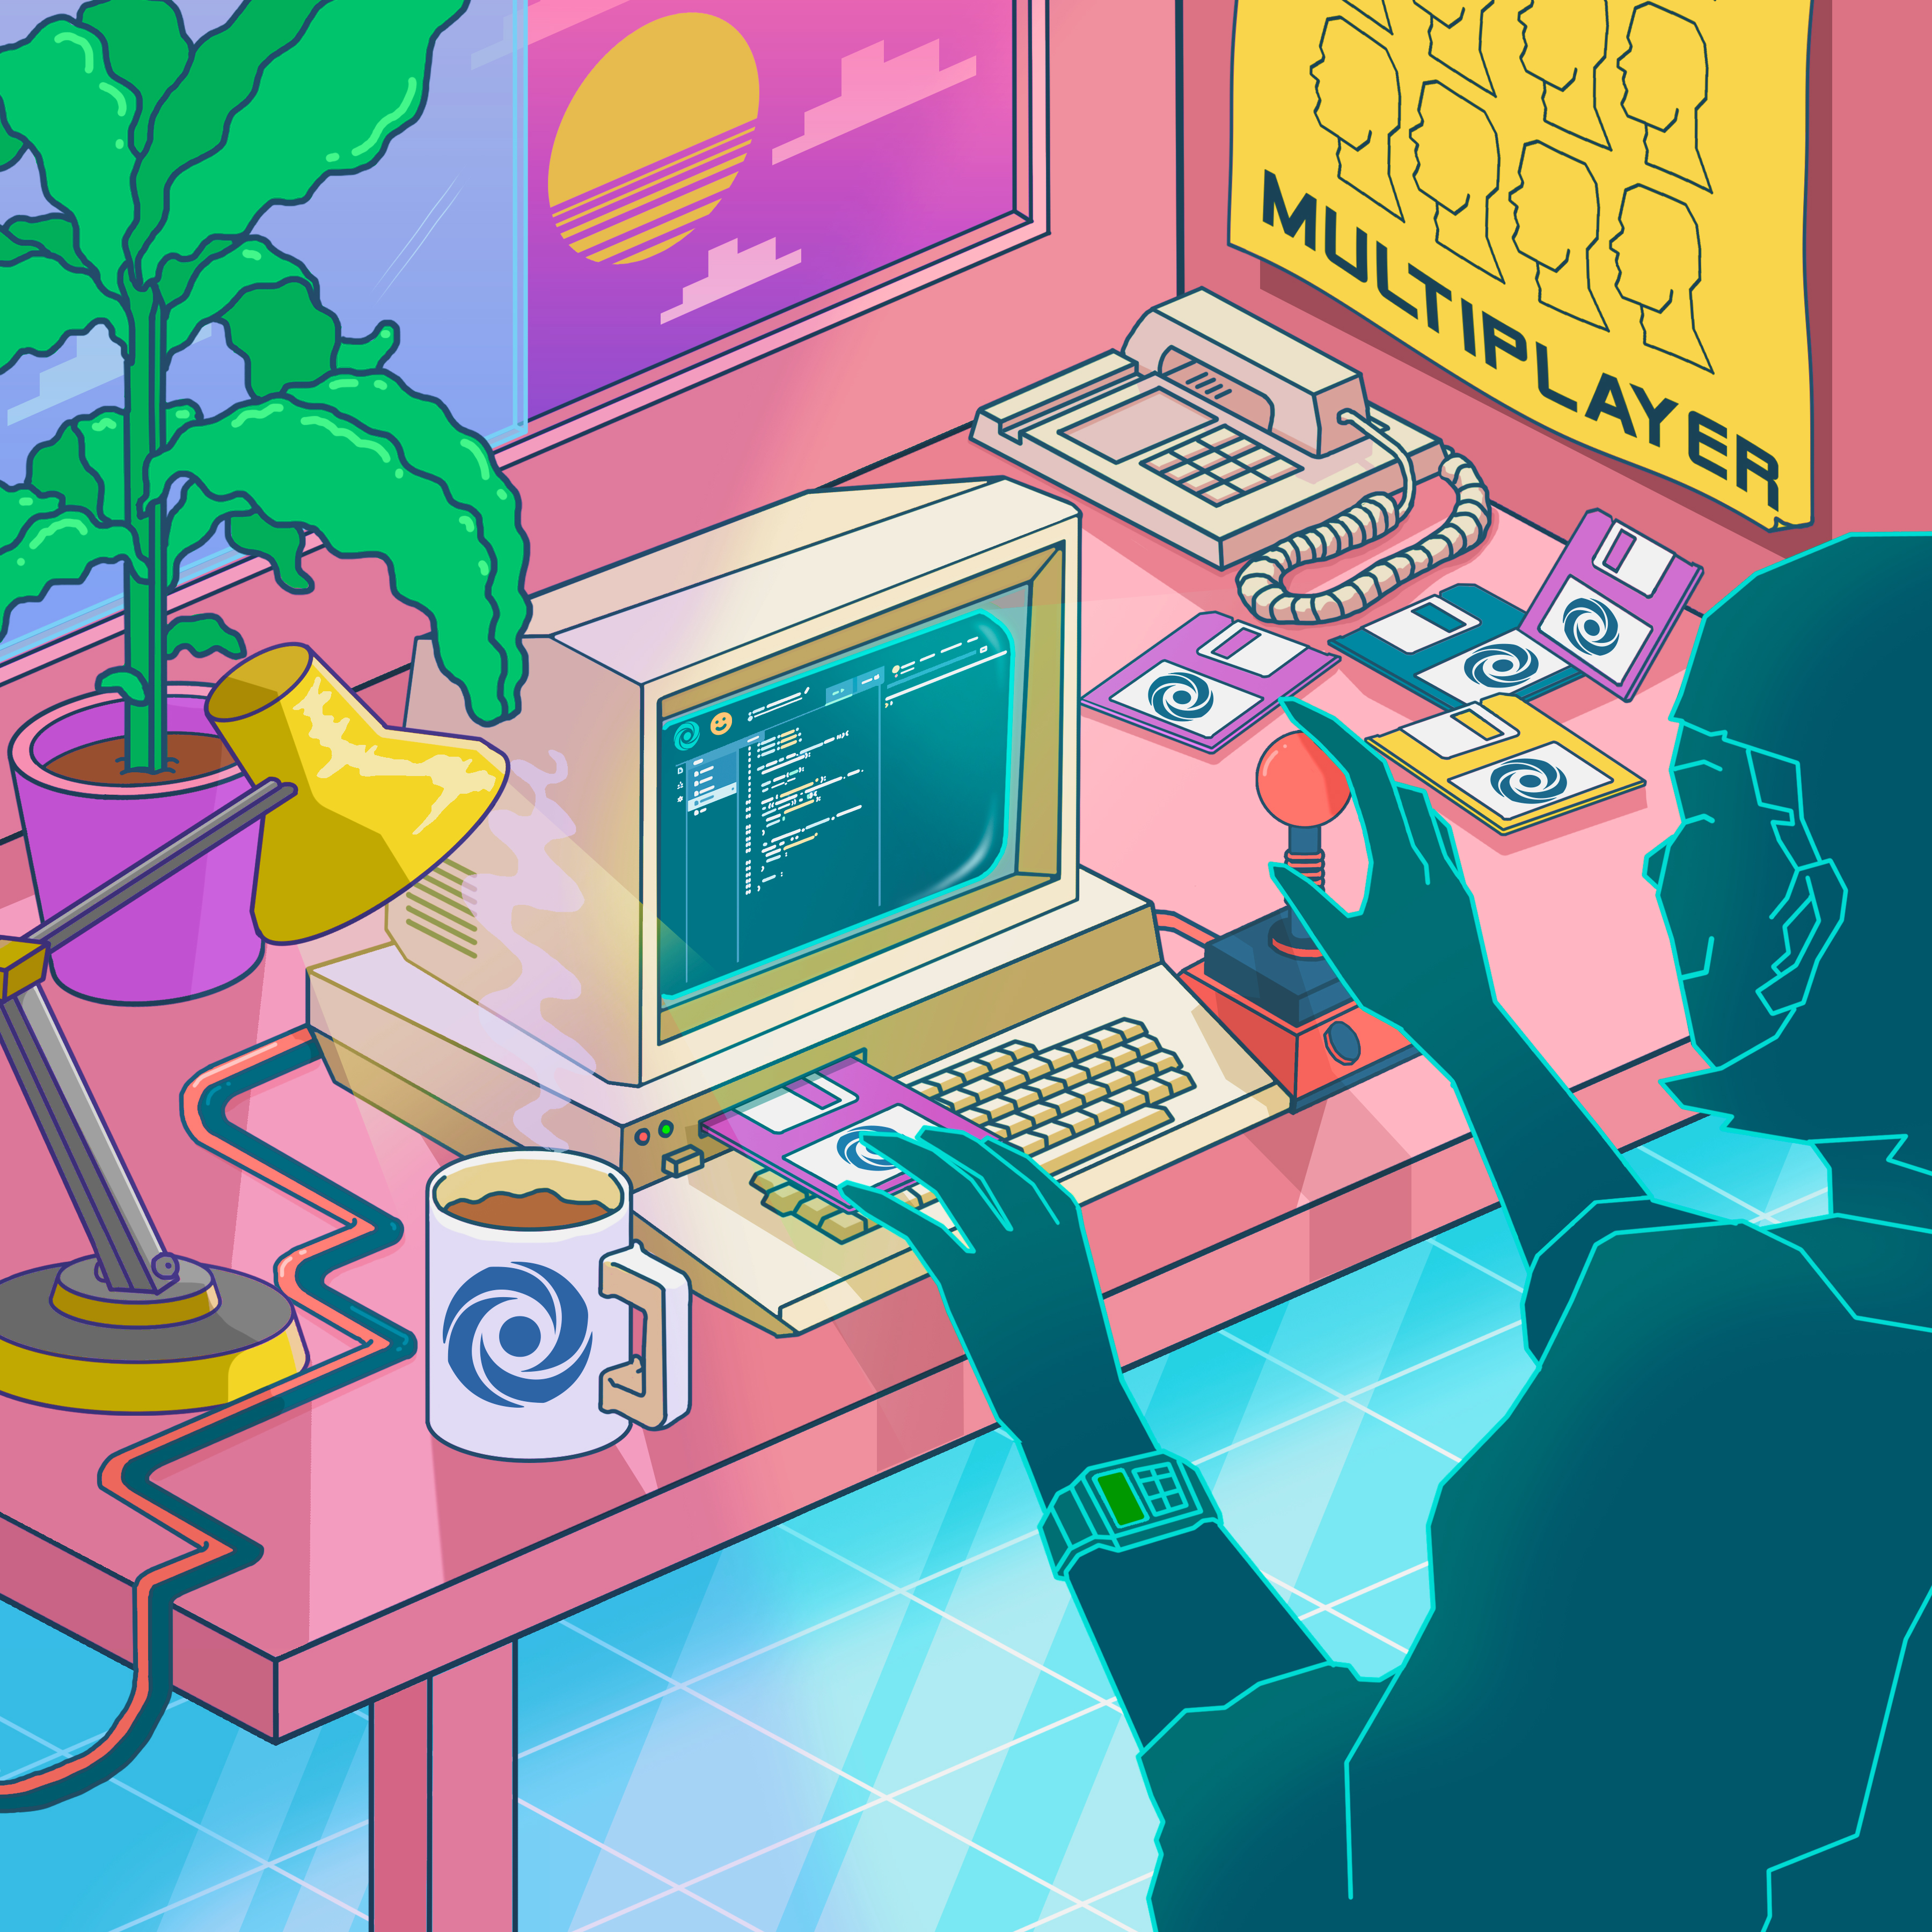

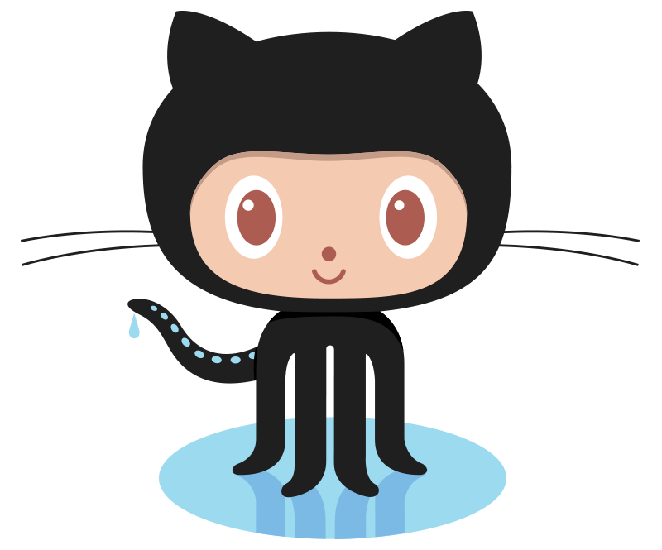
Collaboration Tools
Replit.com Multiplayer
Live chat
Live editing
Easy to connect
Like Google Docs for code
VS Live Share
Great IDE features
Use Visual Studio or VS Code
More complex
GitHub – Join the Workshop Session!
Notes:
There are many ways to collaborate, so your team should use whatever works best for you. Two good ones are Repl.it’s Multiplayer feature, and Visual Studio’s Live Share feature.
Repl.it will probably be easier for beginners. It makes everything pretty easy, but the IDE is not the most full-featured. VS Live Share works with Visual Studio and VS Code. Both are great IDE’s, but they aren’t online and aren’t always super easy to set up.
One of the coolest ways to collaborate is using GitHub – this is a professional tool used by developers in lots of places. It can be complex to learn, but it is worth practicing! Join the session later today to learn more.

Slide 16
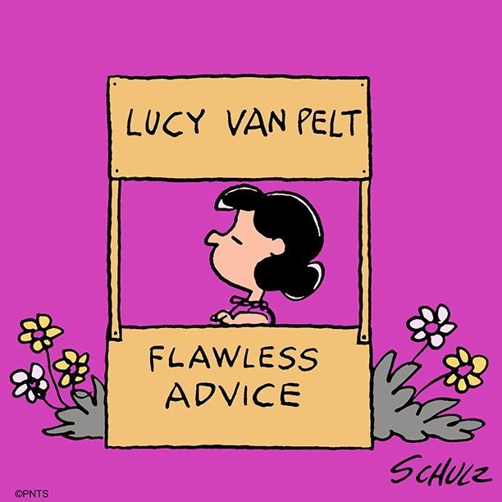
General Advice

Slide 17

How to survive coding for >24HRS
You cannot make a good product if you are not in good shape…
Notes:
Go over some basic self-care points.

Slide 18
How to survive coding for >24HRS
Throughout the weekend, try stay clean! Wash up, brush your teeth, change your clothes. If you’re in person, we have showers!
Try to eat something other than candy (and drink more than just coffee and energy drinks). If you’re in person, we will feed you!
Try to sleep – even short naps can be very helpful. If you’re in person, we will have quiet areas available!
Get outside, go for a walk, step away from the screen every once in a while. We will offer activities throughout the event if you want to take a break and have some fun!
Notes:
Go over some basic self-care points.

Slide 19
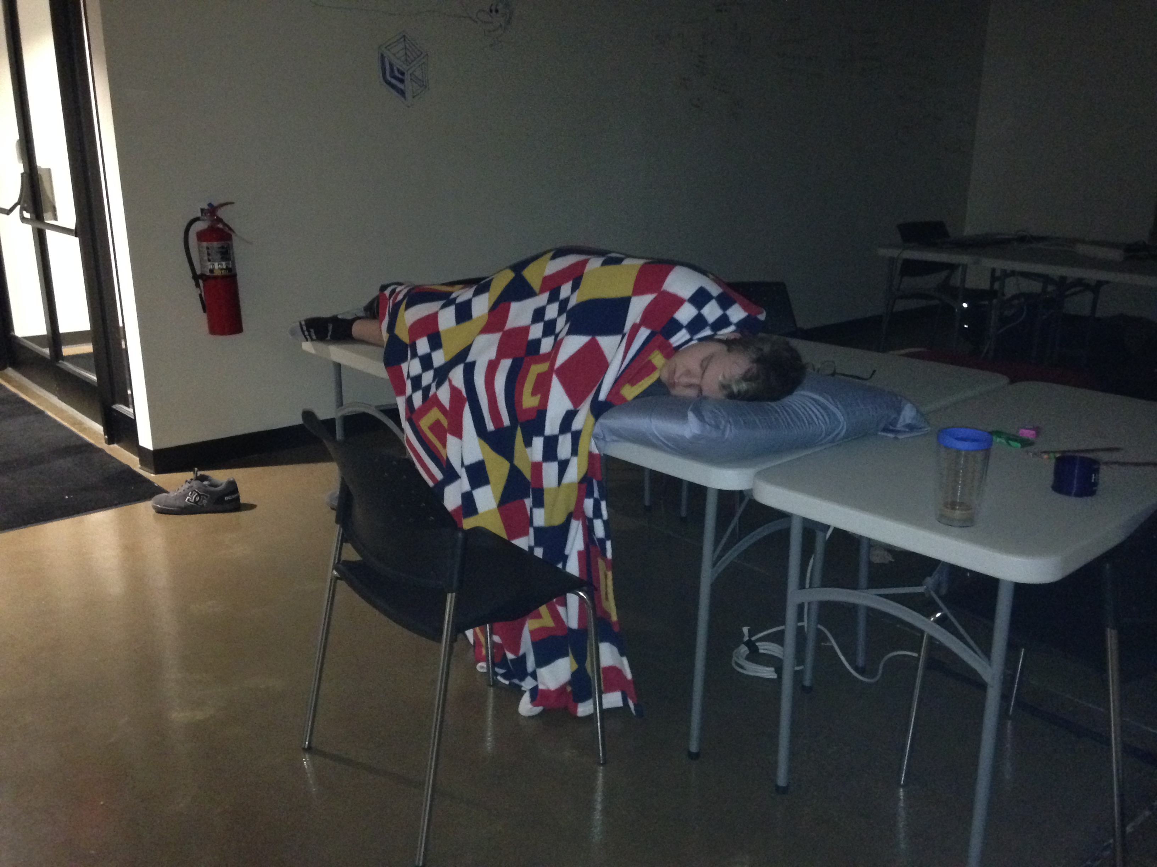

Slide 20
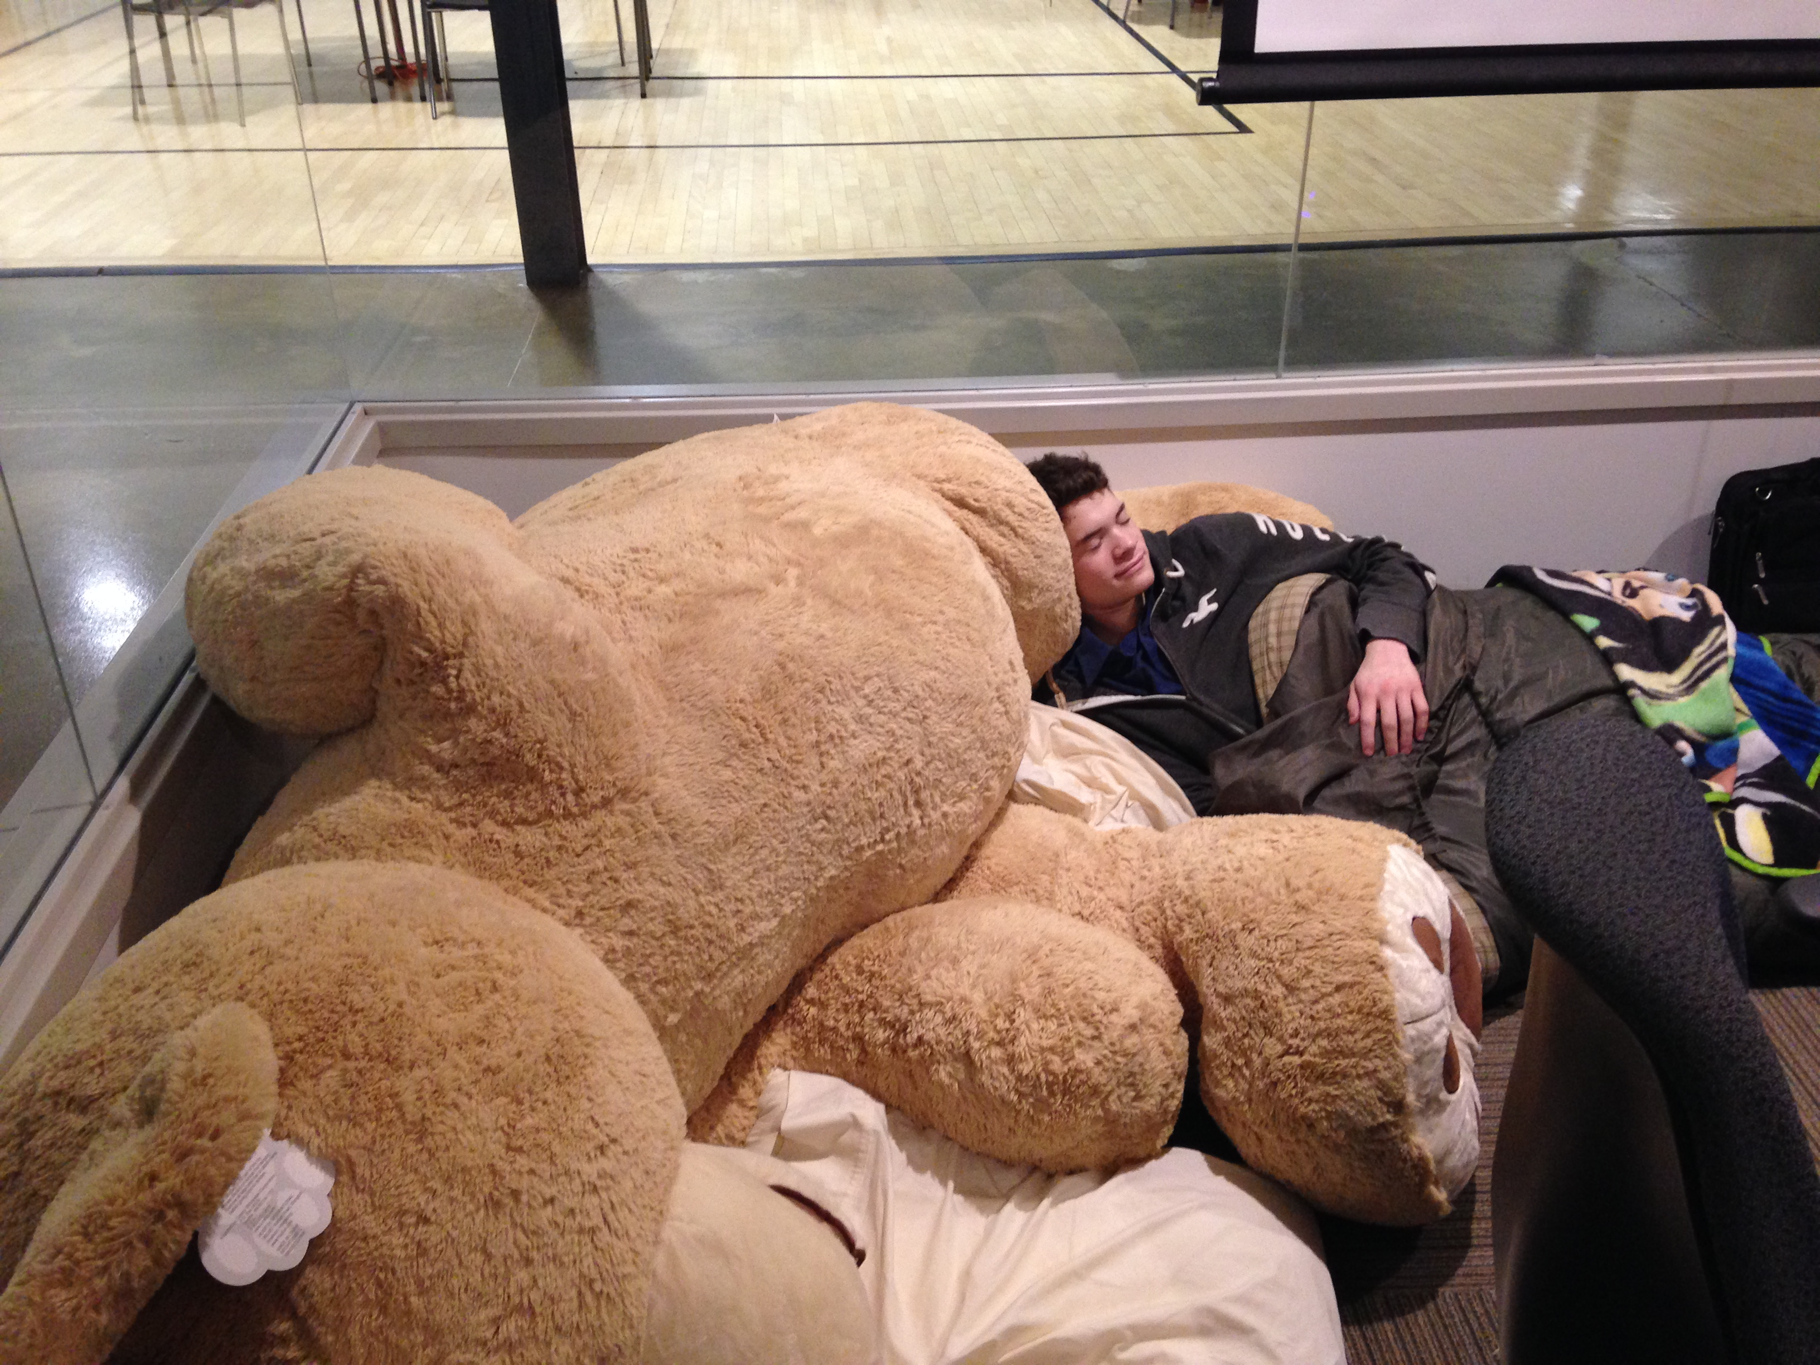

Slide 21




What if I’m completely new to this?
Hackathons can be a fantastic learning experience!
Notes:
If a student has never coded before, they should try to learn how to code. There are a lot of great resources online for beginners. Don’t be afraid to learn something new – even if it takes a long time! Know that one of the best ways to learn is to have a project in mind, and try to create it.
W3schools.com, codecademy, and code.org are good places to start for a total newbie. Use what you learn to build something, even if it’s small!

Slide 22
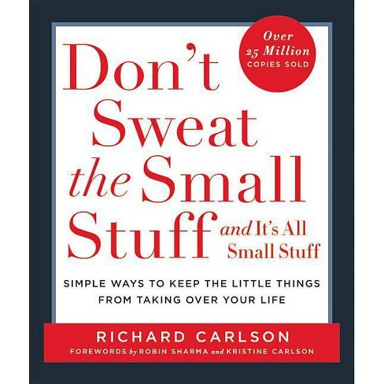
Don’t sweat the small stuff
You underestimated how much time you had, you used a language you never used before, you had a bunch of technical difficulties…
Hackathons are more than a competition.
Networking and making friends
Practicing your skills
Learning something new
Simply having fun
As long as you enjoyed your time and became a better developer, you won!
Notes:
Note that there are also superlatives – so even if your project is a total failure, you could still win something like Best Dressed, Most Improved, or things like that!

Slide 23
Important takeaways
Do
Don’t
Practice self-care: sleep and keep up on hygiene
Take the time to plan your project, and make sure it is scoped appropriately
Use existing libraries if necessary
Focus on learning
Have fun!
Burn yourself out ONLY working on your project
Spend your whole night debugging one line
Work on only boring parts of the project (e.g. authentication)
Take it too seriously

Slide 24


Inspiration
This hackathon could be the beginning of something great…
A project that didn’t even win at TechCrunch Disrupt
Became a real product and company
Sold to Skype for $85 million
Hacking for Charity
20 projects that help non-profit organizations
A different kind of impact
Notes:
Group me is one example of a company that started from a Hackathon. Apart from coming up with a million-dollar idea, you can consider hacking for good! One example of a hackathon for charity is GiveCamp in Cleveland. They do projects that can have a big impact on people – they may not make money, but they are used by these organizations and have a great impact.

Slide 25
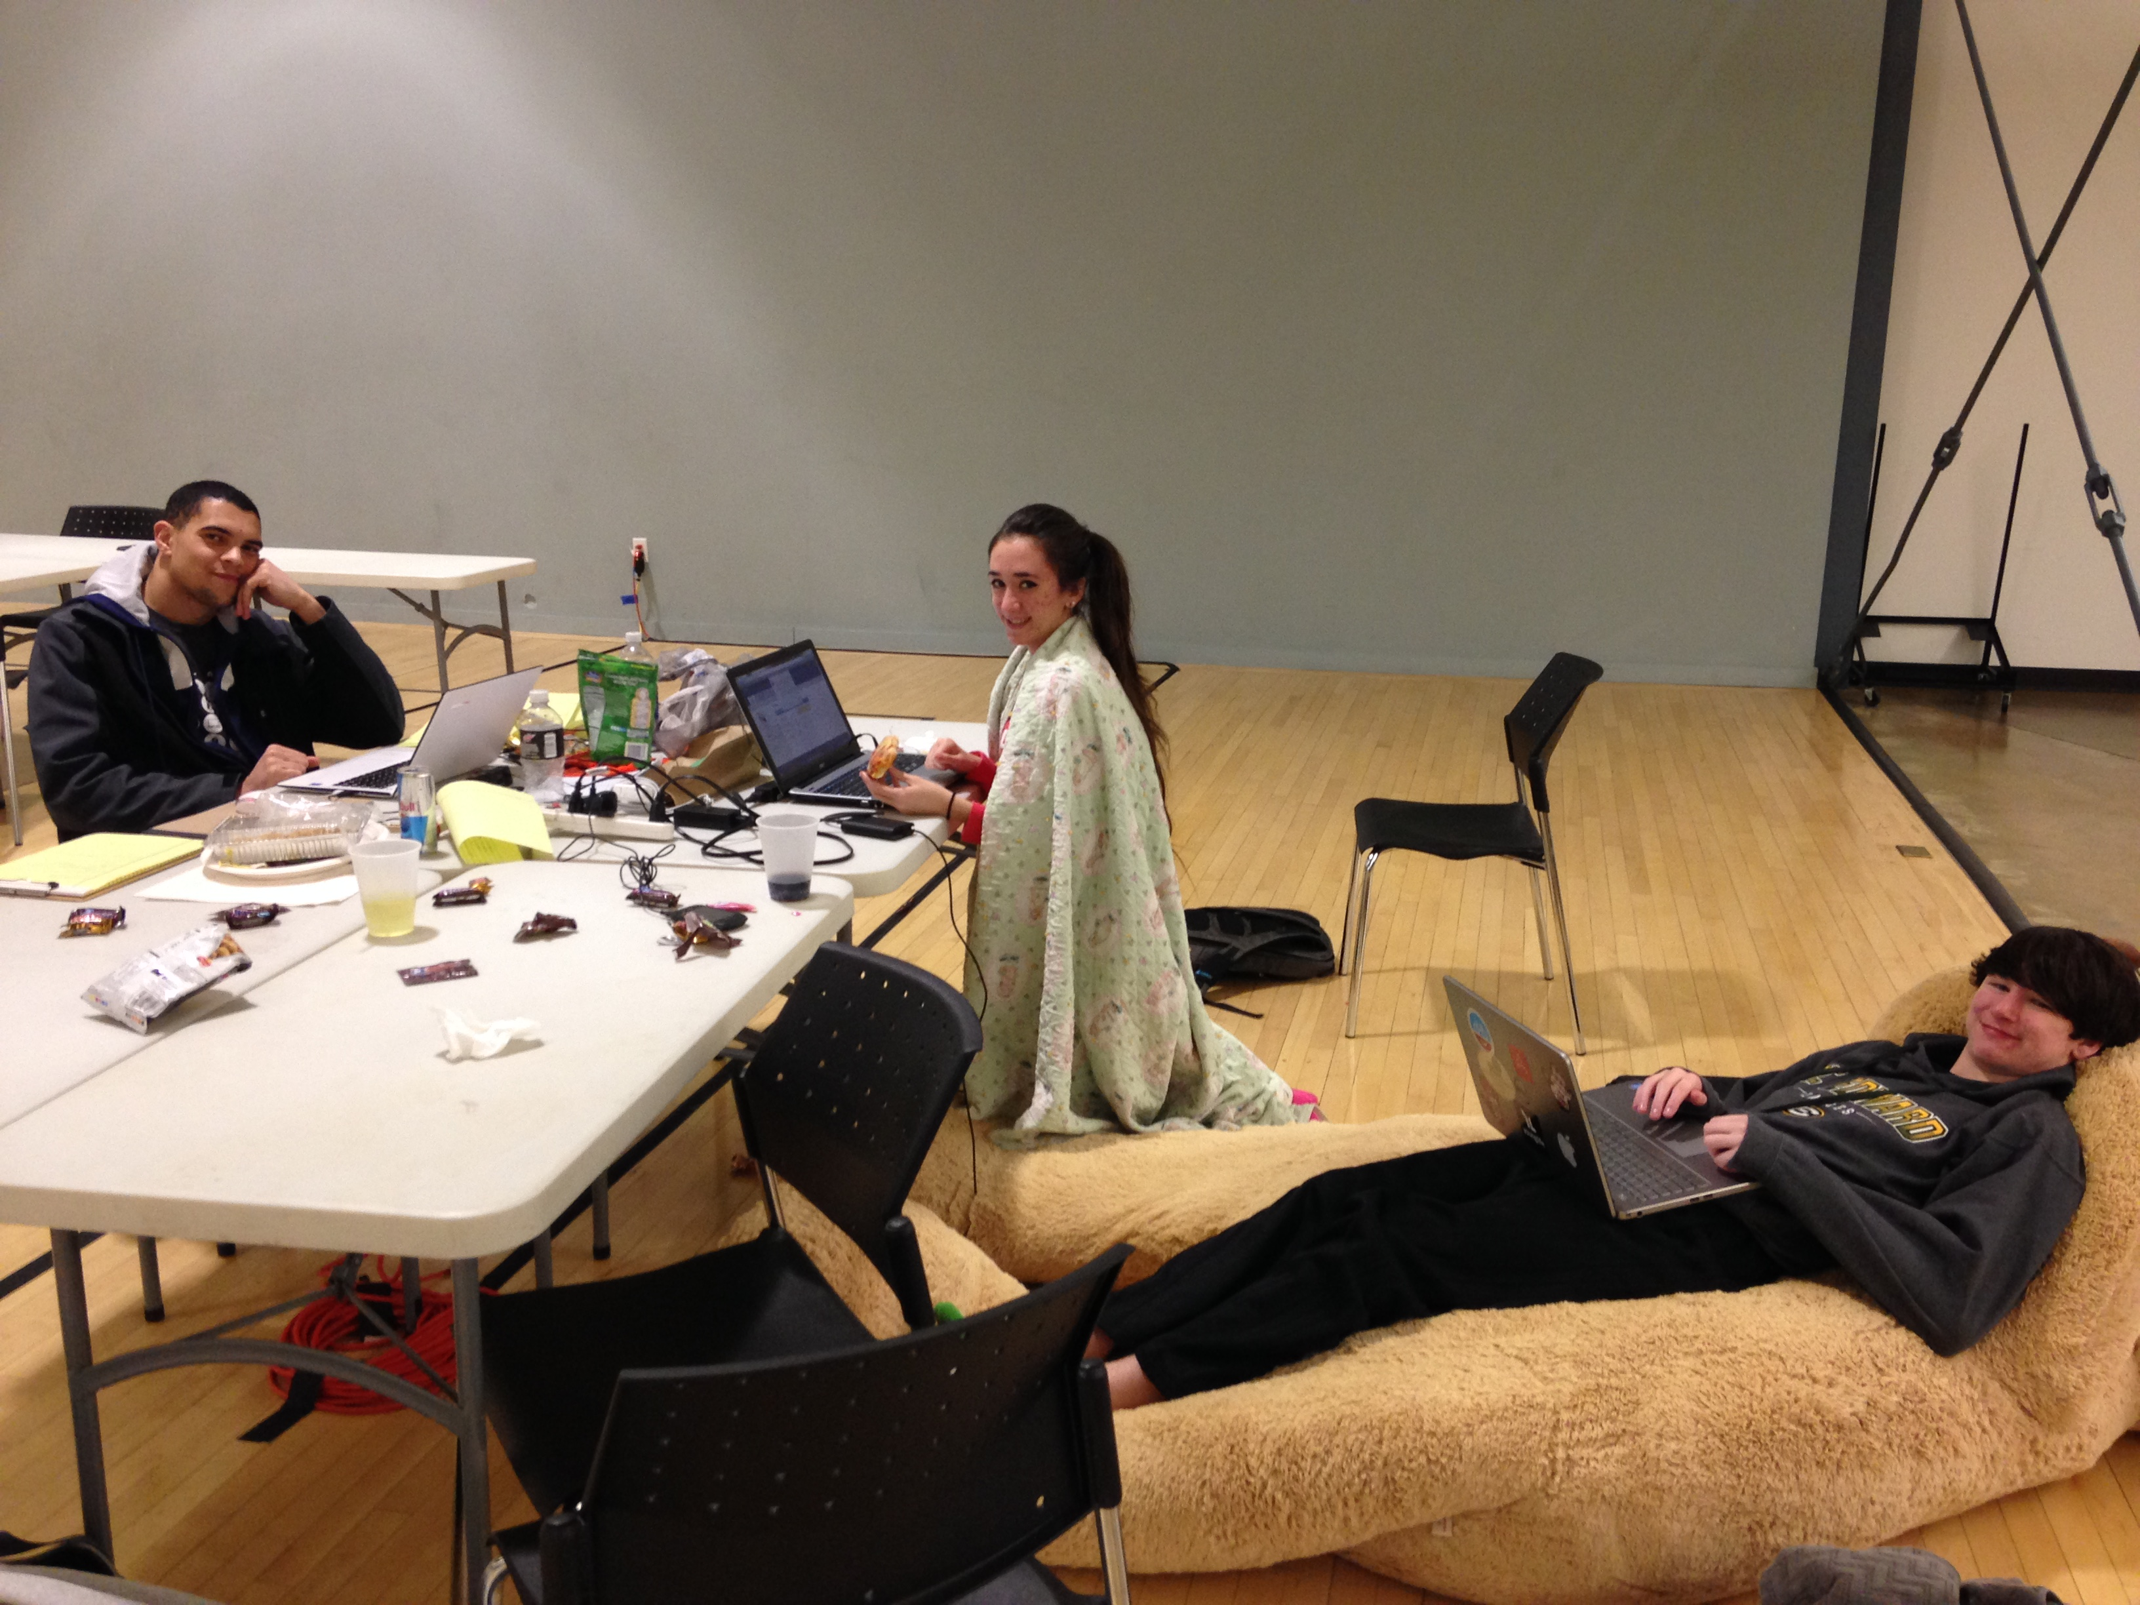

Slide 26
If you only do what you can do, you will never be more than you are now.
Master Shifu
Kung Fu Panda 3

Slide 27
Questions?

